Slide 1

Annual Parish Meeting Tuesday 15th April 2025
Annual report highlights
The full reports are available on the website: www.fressingfield-pc.gov.uk

Slide 2
Village Recorder: Andrew Vessey
Andrew writes about the whatever is going on in the parish, month by month
A fascinating insight into life today in our part of High Suffolk
For more details, please see the full report on the website

Slide 3
Tennis Club
Membership of approx. 50 - always looking for new members for tennis at all levels
A club for all ages and levels with courts always open to members
Coaching for all ages - Saturday morning junior coaching throughout the year
Club Night on Fridays 6:30pm from April to October

Slide 4
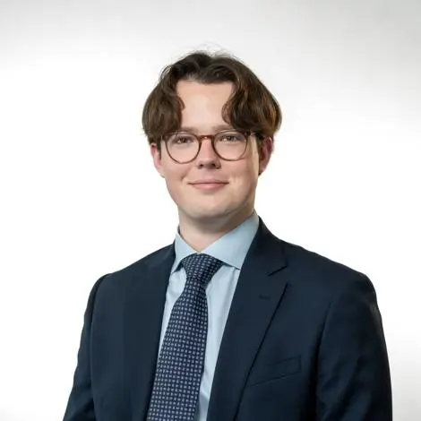
Suffolk County Council
Cllr Henry Lloyd is our County Councillor
Devolution is the topic of much discussion at the moment. Suffolk is on the government fast track to achieve this
97.5% of pupils receive a place in one of their preferred secondary schools on National Offer Day

Slide 5
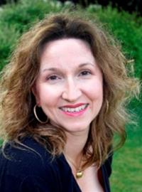
Mid Suffolk District Council
Cllr Lavinia Hadingham is our local Ward Councillor
Groundbreaking for £18 million skills and innovation centre – boosting business in the East
£500K boost for community projects thanks to developer funding

Slide 6

Scouts
Provides challenges & opportunities for young people to contribute to the community
Continue to develop and improve our new site
Explorer expedition to Iceland last Easter
Increase of 10 new youth members
Looking to expand number of adult volunteers – opportunities exist for anyone aged 18+

Slide 7
SAFE
At a local level the Mid Suffolk housing target will increase from 535 to 734 per annum (37%)
Maintain and frequently update our website
Continue to examine new planning applications and new planning policies

Slide 8
Royal British Legion
Regular meetings at Sports and Social Club inc talks by 1st Fressingfield Scouts (the Explorers) about their trips to Kenya and Iceland & RBL President George Watson
Visit to RAF Honington Heritage Museum
New members are welcome to join, whether or not they have been in the Services

Slide 9
Bell Ringers
Wednesday evenings and Sunday mornings the bells ring in the village
New experience ringer joined the male/female team – bringing numbers up to 8
Welcome volunteers who would like to learn to ring and swell our numbers

Slide 10
Parish Council
We were consulted on 15 planning applications in the year
Supported by local ward councillor Lavinia Hadingham and County Councillor Henry Lloyd – funded projects which parish clubs have applied for
All residents are encouraged to attend council meetings and make points or raise concerns during the public forum

Slide 11
Parish Church
Regular formal & informal parish worship services throughout the year
The ancient building is a centre for community activities throughout the year
Continues to develop and maintain its spiritual life and purpose across Fressingfield and the wider community

Slide 12
Wakelyns
3 main community events Agroforestry open day, Dal Festival and Apple Day
Regular programme of Tree Walks, Bird Walks and Willow Weaving continued through the summer
Look forward to welcoming everyone from Fressingfield in 2025

Slide 13
Fressingfield Shed
Open to women and men for connection, conversation, and creation
2nd year of operation, involving lots of activities to expand the membership and improve the physical set up
Underpinning ethos is of companionship, sharing interests, learning new skills. An environment of support.

Slide 14
FLHAG (Fressingfield Local History and Archive Group)
40 members enjoyed full programme of meetings including a visit to boat builders in Woodbridge – creating a replica of the Sutton Hoo Ship
Aims to preserve archives of Fressingfield history – new equipment purchased to help digitize
Aims to preserve archives of Fressingfield history – new equipment purchased to help digitize

Slide 15
Community Gardeners
Monthly meetings 3rd Monday of the month and regular visits: new members always welcome
Talks on all things gardening in friendly atmosphere of Sports and Social Club
Planning Open Gardens type event for 2026 to rival the successful one in 2023 – any ideas?

Slide 16
Bowls Club
For over 100 years the club has welcomed bowlers - all levels of skill and experience
Tuesday roll up sessions open to all members – new members welcomed
Open Day on Saturday May 10th 10am – 1pm
Regular social meals and drinks during the playing season April - September

Slide 17
Fressingfield SOUNDS
Established in 2023, a new music society for the parish and regions beyond
Inaugural concert staged on September 14th 2024, internationally renowned Marmen Quartet
31st May 2025 – Next concert Pianist Clare Hammond at Chapel Hall Arts

Slide 18
Sports & Social Club
Tennis Courts, Bowl’s Green, Darts, Pool, Table Tennis, Football fields and recently renovated Bar
Events - Discos, Race Nights, Quizzes and Bingo
Every resident of Fressingfield is a member. Everyone is welcome!

Slide 19
WI
Current membership of 30 enjoyed interesting speakers and excellent outings. A Very busy year
Soup and Cake event held in the Sancroft Hall raising funds for the Food Bank
Outings this year included, River Barge on the Orwell, Southwold Summer Theatre, Fullers Mill gardens in May

Slide 20
Art and Craft Group
Steady membership of around 30, with 4 new members in 2024
Exhibited two Christmas trees at Stradbroke Christmas Tree festival
Cross-stitch, embroidery, quilting, knitting. Whatever your skill you are welcome to join us

Slide 21
Croquet Club
Season starts officially on Easter Monday
First Golf Doubles Tournament on the Sancroft Hall Green in 2024 – 16 entrants
Coaching and equipment for newcomers on Wednesday and Saturday afternoons 2pm at Sancroft Hall Green

Slide 22
Baptist Church
Aims to love God, love each other and love other people
Annual events - Holiday Club, Easter Egg Hunt and Harvest Supper
Coffee shop going from strength to strength – enjoy excellent coffee, cakes or light lunches. Wednesday-Friday 10am – 2pm

Slide 23
Stables Project
Aiming to secure planning permission for project to use the building for the community needs
Many challenges in working with a historic building in a conservation area
Working closely with Kirby Architecture to refine what Heritage and MSDC planning would accept

